Slide 1
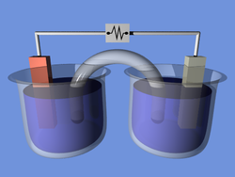
Redox and electrochemistry

Slide 2
Assigning oxidation numbers
1. All elements in the free state have an oxidation number of zero. Ex. Na or H₂
2. If it is an ion equals the charge on the ion. Ex. Na+1
3. Metals in group 1 have (+1) ox #. Ex. NaCl
4. Metals in group 2 have a (+2) ox#. Ex. CaCl₂
5. Hydrogen is always (+1) except in
metal hydride (-1) LiH
6. Oxygen is always (-2)
exceptions: With flourine (flouide) +2 OF₂
In Peroxides (-1) H₂O₂
7. The sum of all oxidation #’s must = 0
8. The sum of all Polyatomic ions must equal the charge of that ion

Slide 3
Assigning oxidation numbers
Binary Compounds
1. Start with the Non Metal
2. Finish with the Metal
3. Sum up must = 0

Slide 4
Assigning oxidation numbers
Ternary Compounds
1. Start with the Non Metal /oxygen
2. Go to the Metal/hydrogen
3. Finish up in the middle
4. Sum up must = 0

Slide 5
Redox Reactions (reactions where both Oxidation and Reduction take place)
1. Oxidation
Reduction
Loss of Electrons
Half Reactions Mg⁰ → Mg⁺² + 2e⁻
(product)
The gain of Electrons
Half Reaction
2e⁻ + Mg⁺² → Mg⁰
(reactant)
Leo says ger
Oil rig
Causes the Reduction of the other elements
Acts as a REDUCING AGENT (R.A.)
Causes the other species to be Oxidized.
Acts as the Oxidation Agent (O.A.)

Slide 6
Oxidation versus Reduction
OIL-RIG
LEO the lion goes GER
Oxidation
Loss of electrons
Ox# increases
Reducing agent
Reduction
Gain of electrons
Ox# decreases
Oxidizing agent

Slide 7
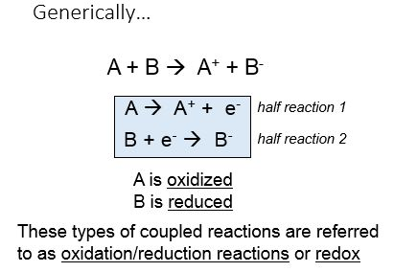
Writing half reactions determine the Ox / red ra / oa
Steps:
1. Assign the Ox #’s
2. Record the changes
3. Record e- loss / e- gain
4. Determine the species that is oxidized (RA) and reduced (OA)
5. Balance if unequal
All Redox Reactions must demonstrate conservation of both Mass and Charge

Slide 9
Balancing Redox reactions
Half-reaction Method:
1. Assign oxidation numbers
2. Decide which element is oxidized:
(oxidized/ox. # inc./lose electrons/reducing agent)
3. Decide which element is reduced:
(reduced/ox. # dec/gain electrons/oxidizing agent)
4. Write the two half reactions.
5. Balance electrons lost and gained.
6. Use the coefficients to help balance the equation.
7. Balance by inspection:
(save single elements, hydrogen, oxygen and water for last)

Slide 10
Examples:

Slide 12
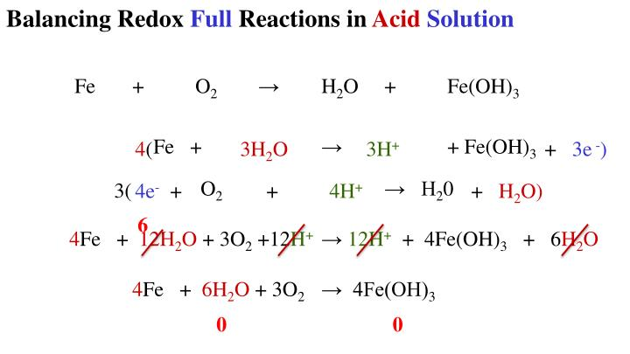

Slide 15
Spontaneous vs. Nonspontaneous Reactions
Table J
Table J:metals replace metals below them.
Nonmetals replace nonmetals below them
Old table N
Positive e volt

Slide 16
Table J
Metal:
Most active:
Easy to lose
Easier oxidized
Better reducing agents
Inactive:
Harder to lose
Easier reduced
Better oxidizing agents
Nonmetal:
Most active:
Easy to gain
Easier to be reduced
Better oxidizing agents
Inactive:
Harder to gain
Easier oxidized
Better reducing agents

Slide 17
Old table N
All reductions
Flip sign for oxidation
For net reaction:
+Evolt/spontaneous/
Electrochemical cell
-Evolt/not spontaneous/
Electrolytic cell

Slide 18
Electrochemical cell Spontaneous cell (battery) Voltaic cell, galvanic cell (****Chemical energy → electrical ****)
Al
Cu

Slide 19
Electrochemistry
Cells involving both a chemical reaction and electricity

Slide 20
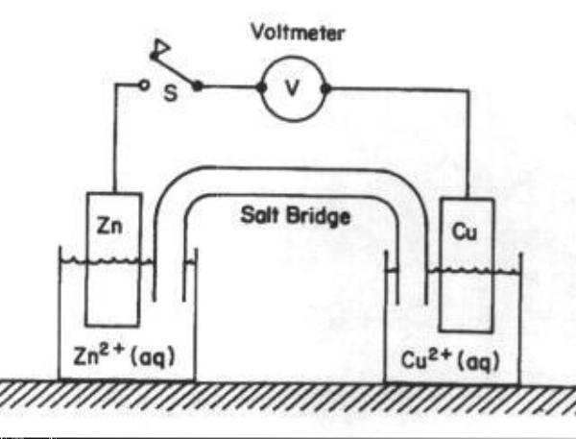
Electrochemical cell Spontaneous cell (battery) Voltaic cell, galvanic cell

Slide 21
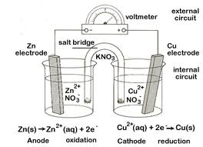
Electrochemical cell Spontaneous cell (battery) Voltaic cell galvanic cell (Zinc/copper)

Slide 22
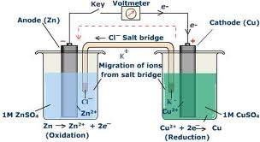
Electrochemical cell Spontaneous cell (battery) Voltaic cell galvanic cell

Slide 23
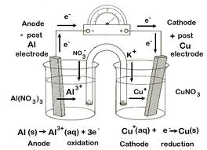
Electrochemical cell Spontaneous cell (battery) Voltaic cell, galvanic cell

Slide 24
Electrolytic cell non-spontaneous cell (need a power source) electroplating electrolysis (****electrical → chemical energy****)

Slide 25
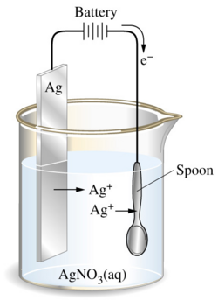
Electrolytic cell non-spontaneous cell (need a power source) electroplating electrolysis (****electrical → chemical energy****)

Slide 26
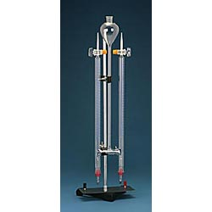
Electrolytic cell non-spontaneous cell (need a power source) electroplating electrolysis of water!!!

Slide 27
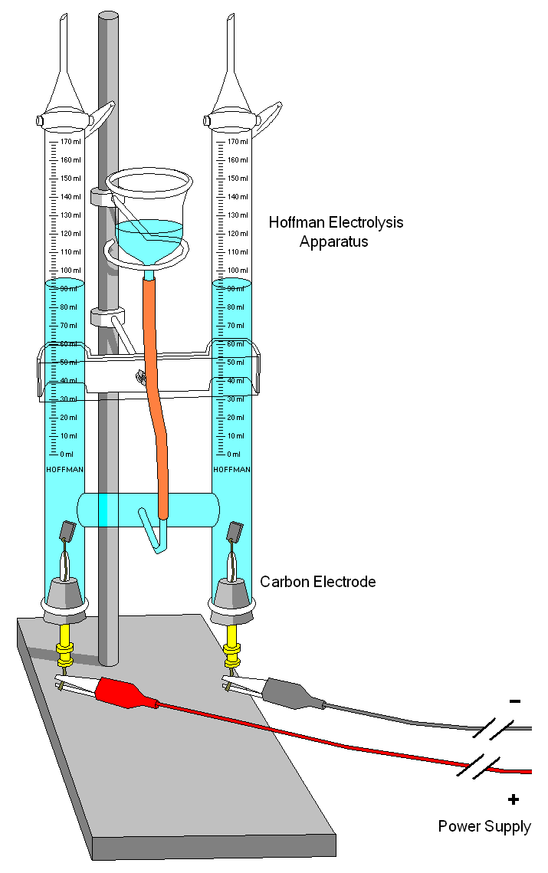
Electrolytic cell non-spontaneous cell (need a power source) electrolysis of water!!!
2H₂O → 2H₂ + O₂

Slide 28
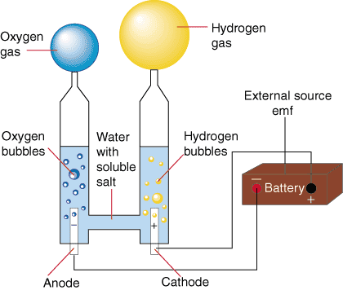
Electrolytic cell non-spontaneous cell (need a power source) electroplating electrolysis of water!!!

Slide 29
Electrolytic cell non-spontaneous cell (need a power source) (separation of a fused salt)
2NaCl → 2Na + Cl₂

Slide 30
Electrochemical versus Electrolytic Cells
AN Ox/Red Cat
AOL/VAN
Electrochemical Cells
(ex: voltaic or galvanic)
A chemical reaction is used to produce an electric current
Spontaneous reaction: (table J/+Evolt)
Anode: oxidation (-)
Cathode: Reduction(+)
Electrons flow through a wire from anode to cathode
Salt bridge: permits migration of ions
Anions: (- ions) flow into anode compartment
Cations: (+ ions) flow into cathode compartment
Electrolytic cells
(ex: electroplating or electrolysis)
Electricity is used to force a reaction
Nonspontaneous reaction:(table J/-E volt)
Anode: oxidation(+ terminal)
Cathode : reduction (-terminal)
Needs a battery
Note: In electroplating
Metal plated: anode
Object: cathode

