Slide 1
CHEMICAL KINETICS

Slide 2
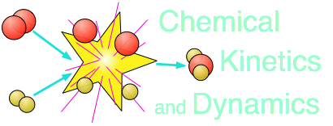
Chemical kinetics: is a branch of chemistry which deals with the __________reaction and the _________by which the chemical reaction occurs.

Slide 3
Rate of Reaction
How _______a reaction occurs
Measure by determining the ______of reactants used up or _____of products produced per unit of volume in a given unit of______
How can you determine the rate of reaction for the formation of ammonia
__________→ 2NH₃ (Haber Reaction)

Slide 4
Reaction Mechanism
___________by which a reaction occur.
For most reactions only the _________is observable.
Formation of carbon dioxide
___________
Mechanism:
C + ½ O₂ → CO( _________/energy activated complex
CO + ½ O₂ → CO₂
_{Net:_____}

Slide 5
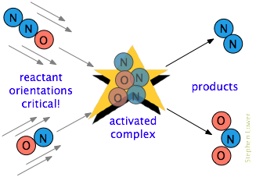
Role of Energy in Chemical Reactions
Activation Energy:
Minimum amount of energy needed to start a reaction.
Slow reactions have a _____activation energy.
Fast reactions have a______ activation energy.

Slide 6
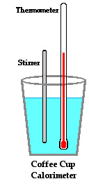
Heat of Reaction: (enthalpy of reaction)
Heat energy absorbed or released in the formation of the products during a chemical reaction.
▲H= H _{products} - H _{reactants}
Heat measure in a__________ in units called________.
Table I (heats of formation)

Slide 7
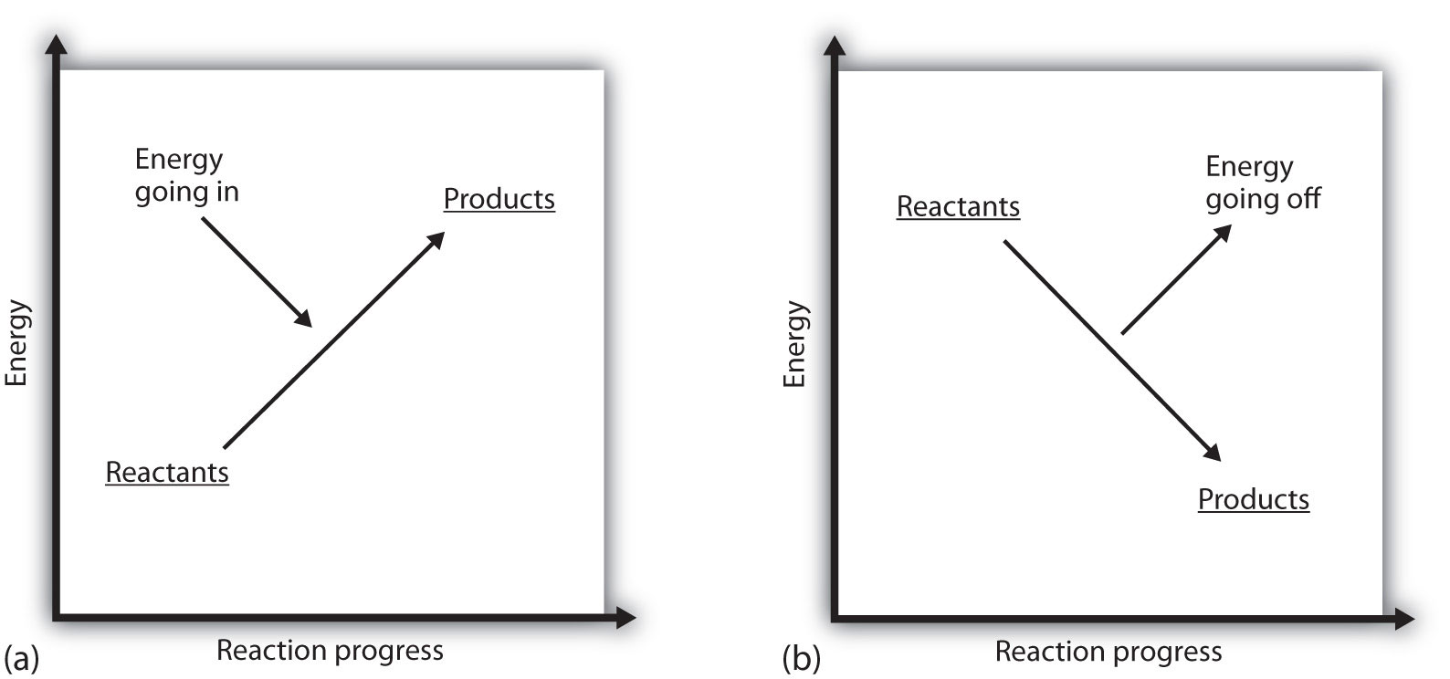
Endothermic Reaction
Exothermic Reaction
Heat is_______
H _{P} ___ H _{R}
▲H = H _{P} - H _{R}
_{▲H is} _____
_{Example from table I}
Heat is_________
H _{R} ___ H _{P}
▲H = H _{P} - H _{R}
▲H is_________
Example from table I

Slide 8
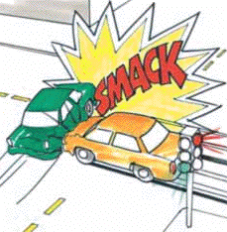
COLLISION THEORY
Collisions must occur between reacting particles.
Collisions must be effective (enough kinetic energy and proper orientation)
______collisions the faster the rate.

Slide 9
FACTORS THAT AFFECT THE RATE OF A REACTION

Slide 10
1. Nature of the reactions
Reactions involving negligible bond rearrangement are usually _____at room temperature than reactions involving extensive breaking of bonds.
Reactions of ______substances in aqueous solutions are faster than reactions involving ______substances.
_____reactions have low activation energies.
_________reactions (reactants are in the same phase) are_______ than ________reactions. (reactants are in different phases)

Slide 11
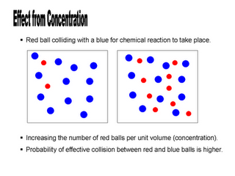
2. CONCENTRATION OF THE REACTANTS
An _______in the concentration of one or more of the reactants→ ______the number of collisions→ _____the rate of reactant.
Concentration is expressed in___________ (__)
______ moles, greater the molarity, the _____the rate.
A______ in volume increases the concentration.
For a _____system only, an ______ in pressure, ______ the rate.

Slide 12
3. Temperature on a System
An_______ in temperature → _______ the______ energy of the particles → molecules move______ → _____effective collisions →________ the rate.
Speeds up the rate of ________an endothermic and exothermic reactions
Rule of thumb: A ten degree Celsius increase in temperature doubles the reaction rate.
Example: Glow Sticks

Slide 13
4. Reaction Mechanism
All reactions occur as a result of a series of steps.
Each step results in the formation of high energy intermediate products called the____________.
The different steps in a reaction mechanism takes place at different rates.
The rate of the overall reaction is determined by the rate of the _________step called the rate determining step. (r.d.s.)
If you know the r.d.s. a change in concentration must be in that step to have an overall affect on the reaction rate.
Analogy: Ordering food in a restaurant

Slide 14
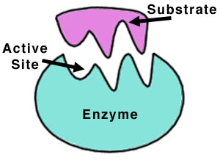
5. Addition of a Catalyst
A__________ is a substance that changes the rate of a reaction while itself remaining generally unchanged after the net reaction.
It alters the pathway of a chemical reaction by_______ the activation energy.
It does not initiate a reaction nor change the reactants and products.
_________catalyst speeds up a chemical reaction. For example: Enzymes are carrier catalyst
________catalyst or inhibitor slows down a reaction.
If it doesn’t specify a catalyst as being an inhibitor assume it to be positive.

Slide 15
CONCLUSION
Step 1: enzyme A + B → I (intermediate product/activated complex)
Step 2: A + I → C enzyme
Net Eq: enzyme 2A + B → C enzyme
(reactants) (products)

