Slide 1
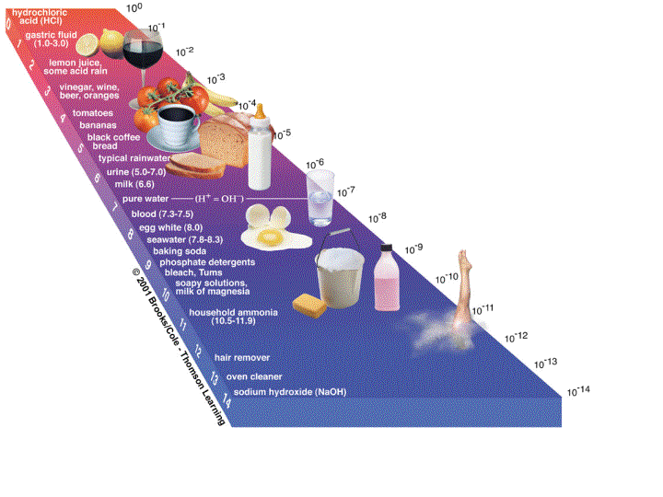
Acid and Base Reactions

Slide 2
Conjugate Acid-Base Pair Bronsted - Lowery
Acid
Base
Proton (H⁺) Donor
Proton (H⁺) Acceptor
H⁺ H⁺
H₂O + H₂O -------------> OH⁻ + H₃O⁺
Strong Acid (SA) ----------> H⁺ + Weak Base (WB)
Weak Acid (WA) ------------> H⁺ + Strong Base (SB)

Slide 3
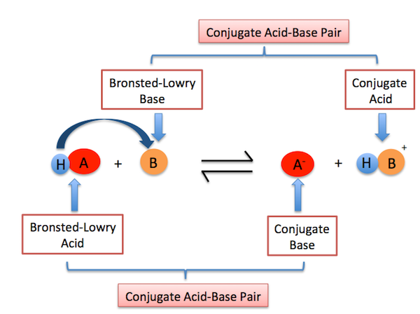
Conjugate acid-base pairs

Slide 4
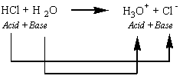
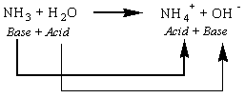
Examples:

Slide 5
The Neutralization Reaction
Acid + Base -------------> Salt + Water
HCl + NaOH --------> NaCl + H2O
What kind of Reaction do you See?
Double Replacement

Slide 7
Titration

Slide 8
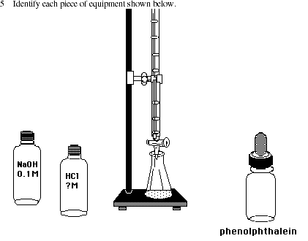
Titration technique:

Slide 9
Steps.
Set up 2 burets using a stand and holder.
Add acid in one buret #1 (standard solution) and base in buret #2 to a point and record the point looking at the bottom of the meniscus. This is the start point for measuring volume.
Slowly add the base to a flask (less volume is better) and record the volume used. Warning……
Add a few drops of indicator (clear)
Place flask under buret #2 (Base)
Slowly add base to flask (watch for a color change to pale pink) ***Do not go past the end point!
Record the volume used.****Warning……..
Insert numbers into the equation!
(#H) M_{A}V_{A} = M_{B}V_{B} (#OH)

Slide 10
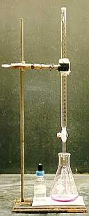
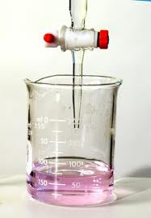
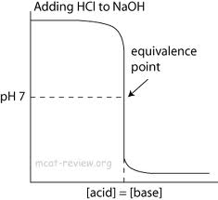
Titration and Calculations
End Point

Slide 11
The Hydrolysis of a Salt The Reverse Reaction
Adding water to a salt!
Water + Salt --------> Acid + Base
H2O + NaCl -------------> HCl + NaOH
Called “The Parent Acid and Base”

Slide 12
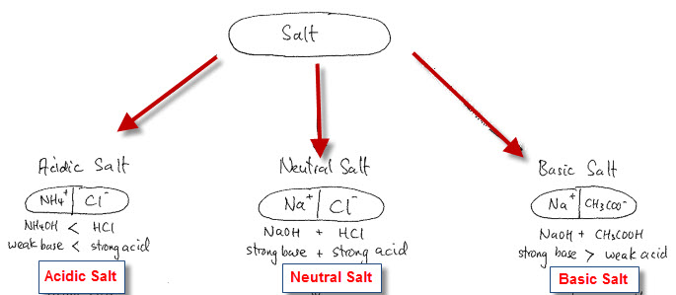
Are all salts neutrals?

Slide 13
pH Scale
pH Scale
Is a scale that is used to measure if a substance is an acid or base
Measures the Percent [H+] (The power of Hydrogen!)

Slide 14
Kw,pH,pOH Calculations
K_{w} (The ionization of H2O)
H₂O <-----------> H⁺aq + OH⁻ aq
K_{w} = [H+] [OH-] Fact K_{H2O} = 1 x 10 ⁻¹⁴
1 x 10⁻¹⁴ = [H+] [OH-]
[H⁺] = 1 x 10⁻⁷ [OH⁻] = 1x 10⁻⁷
Calculate pH
pH = -log[H⁺] pOH = -log[OH⁻]
pH = 7 pOH = 7
pH + pOH = 14

Slide 15
Formulas to know:

Slide 16
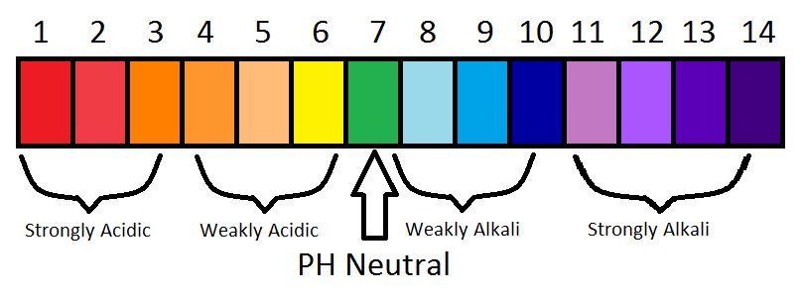
How does pH work?

Slide 17
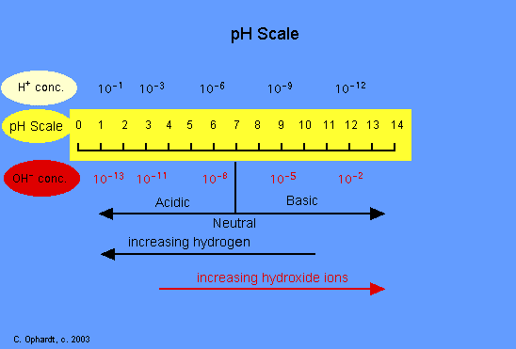

Slide 18
Examples:

Slide 19
Advanced level:

